Slide 1
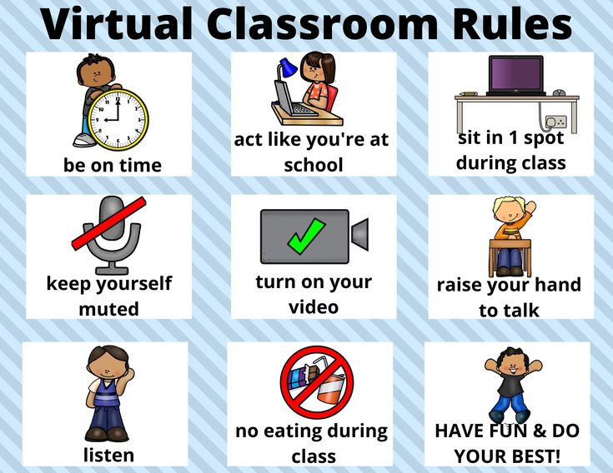

Slide 2
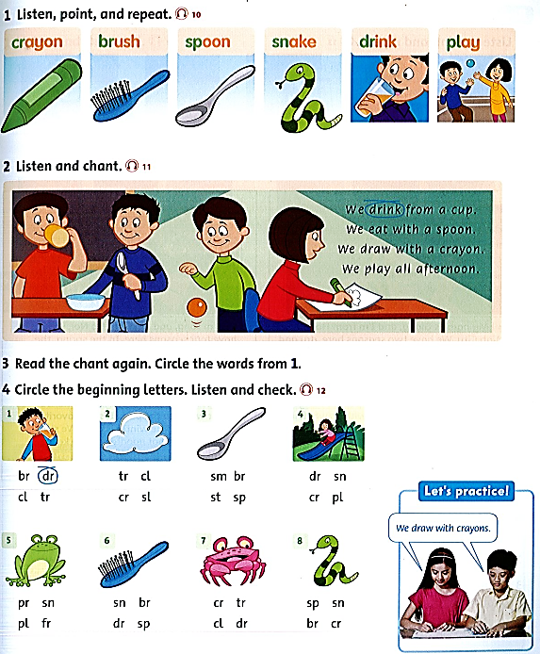
Student’s book page 11.

Slide 5
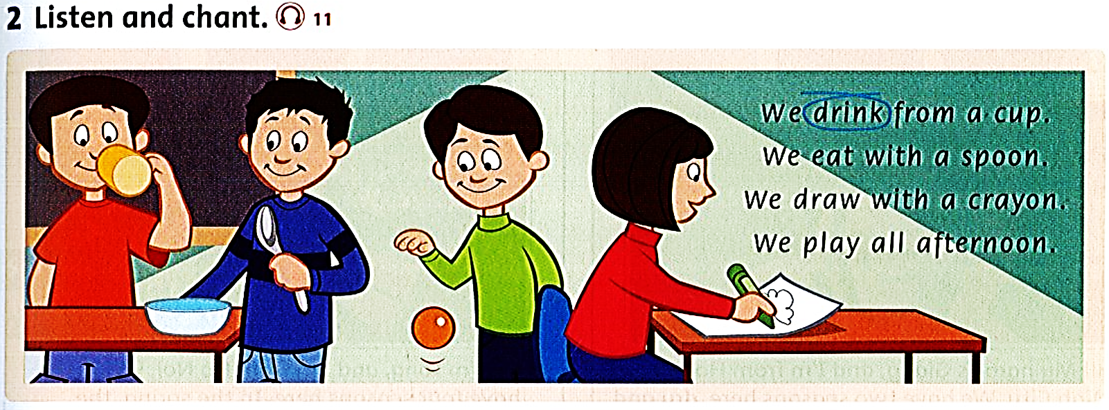

Slide 6
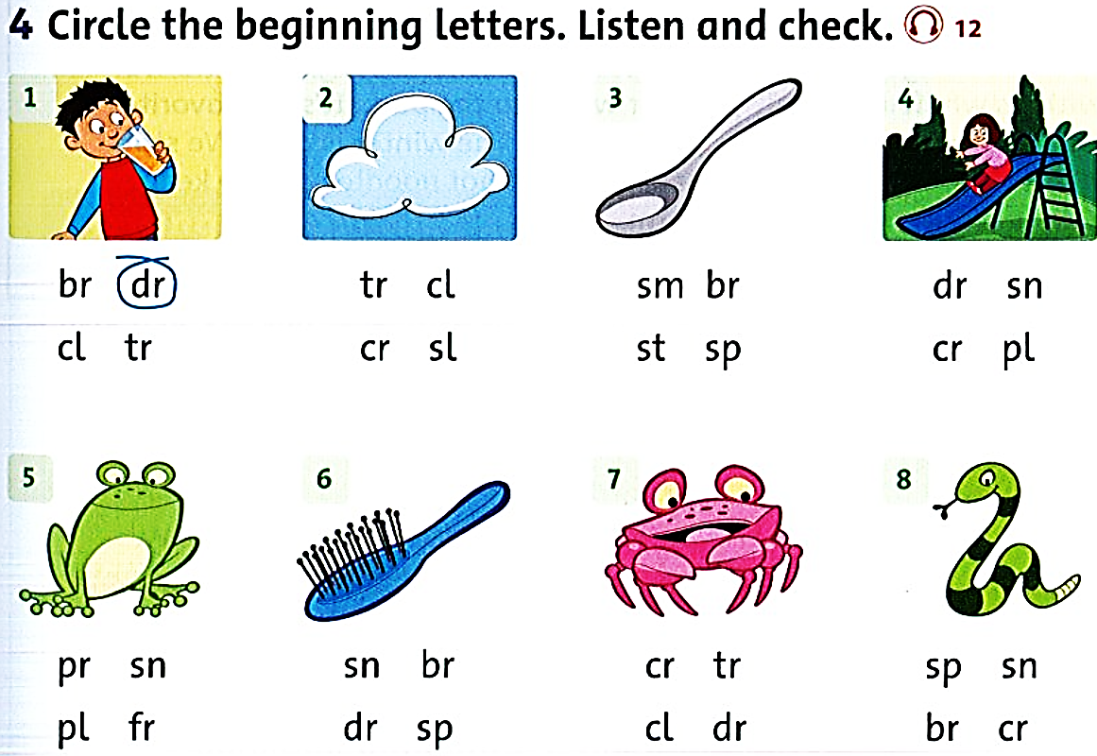

Slide 7
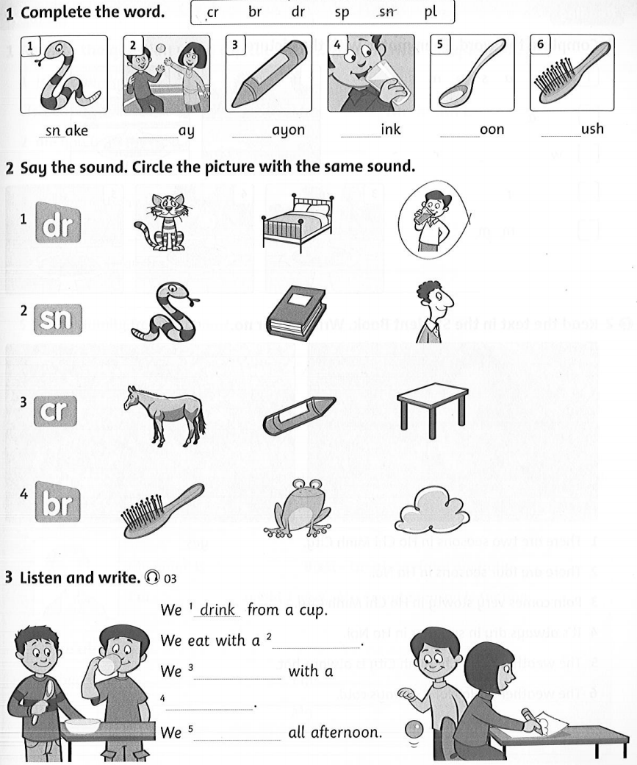
Workbook page 11

Slide 8
pl
cr
dr
sp
br

Slide 10
cup
eat
spoon
play

Slide 11
Homework
Do exercise on liveworksheets
https://www.liveworksheets.com/oa1289762tp
https://www.liveworksheets.com/ev1181773lh
https://www.liveworksheets.com/ya2361949jz

